Slide 1
Quantum Gradient Parameter shift method
2019
5/6/2021

Slide 2
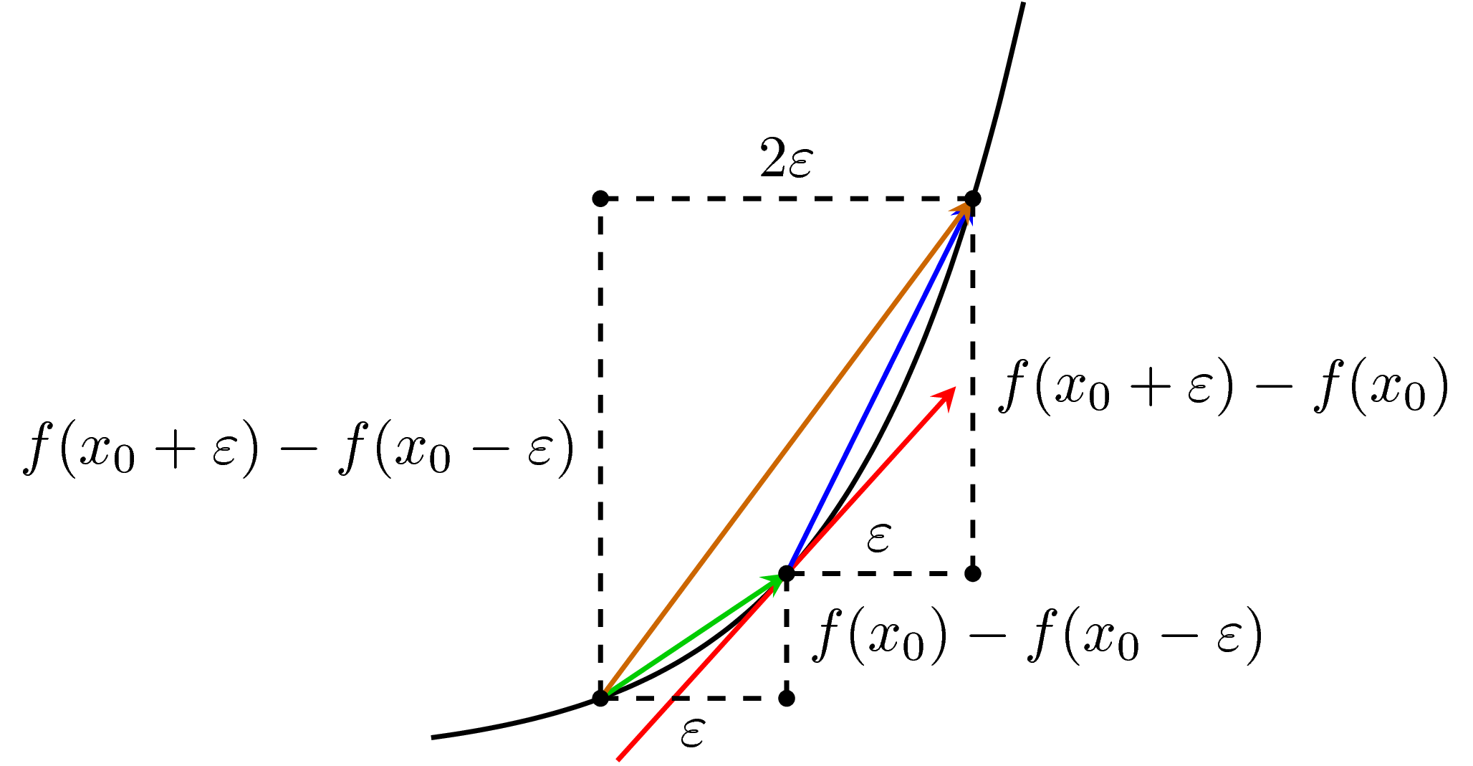
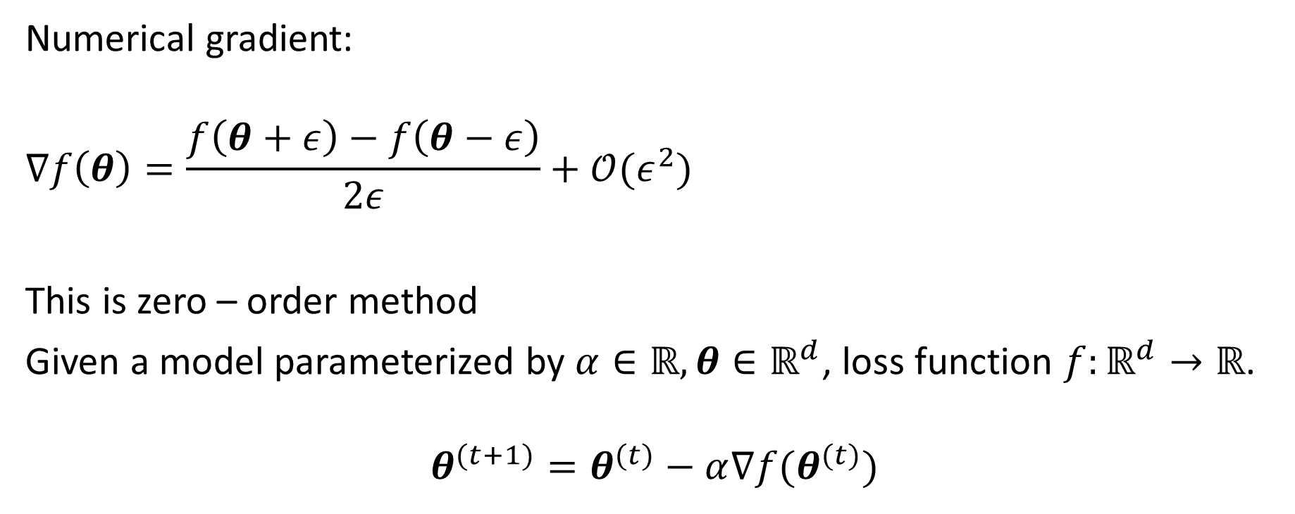

1. Gradient descent
Numerical gradient:
$$∇f\left(θ\right)=\frac{f\left(θ+ε\right)−f\left(θ−ε\right)}{2ε}+𝒪(ε^{2})$$
This is zero – order method
Given a model parameterized by $α∈ℝ,θ∈ℝ^{d}$, loss function $f:ℝ^{d}→ℝ$.
$$θ^{(t+1)}=θ^{(t)}−α∇f(θ^{(t)})$$

Slide 3
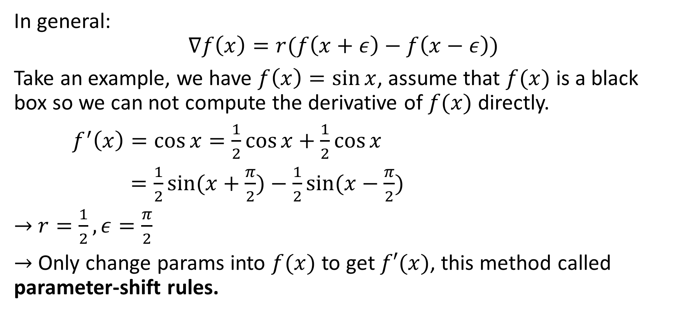
2. Example
In general:
$$∇f\left(x\right)=r(f\left(x+ε\right)−f\left(x−ε\right))$$
Take an example, we have $f\left(x\right)=\sin{x}$, assume that $f(x)$ is a black box so we can not compute the derivative of $f(x)$ directly.
$f^{′}\left(x\right)=\cos{x=\frac{1}{2}\cos{x+\frac{1}{2}\cos{x}}}$
$=\frac{1}{2}\sin{(x+\frac{π}{2})}−\frac{1}{2}sin⁡(x−\frac{π}{2})$
$→$ $r=\frac{1}{2},ε=\frac{π}{2}$
$→$ Only change params into $f(x)$ to get $f′(x)$, this method called parameter-shift rules.

Slide 4
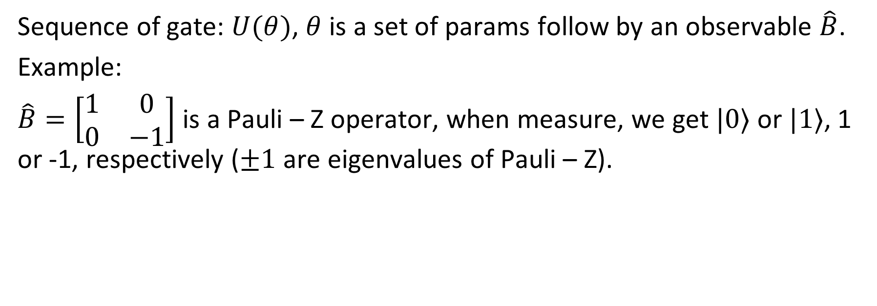

2. Notation
Sequence of gate: $U(θ)$, $θ$ is a set of params follow by an observable $\hat{B}$.
Example:
$\hat{B}=\left[\begin{matrix}1 & 0 \\ 0 & −1\end{matrix}\right]$ is a Pauli – Z operator, when measure, we get $|0⟩$ or $|1⟩$, 1 or -1, respectively ($±1$ are eigenvalues of Pauli – Z).
Observable in QC can simply be a vector or matrix, associated with some real physical quantity like position, momentum, …

Slide 5


2. Notation
To find the expectation of $\hat{B}$:
$$f\left(θ\right):ℝ^{m}→ℝ^{n}≔\left\langle 0\left|U^{†}(θ)\hat{B}U(θ)\right|0\right\rangle$$
Called “expectation” because we have run several times and averages measurement samples to get an estimate of $f\left(θ\right)$.

Slide 6

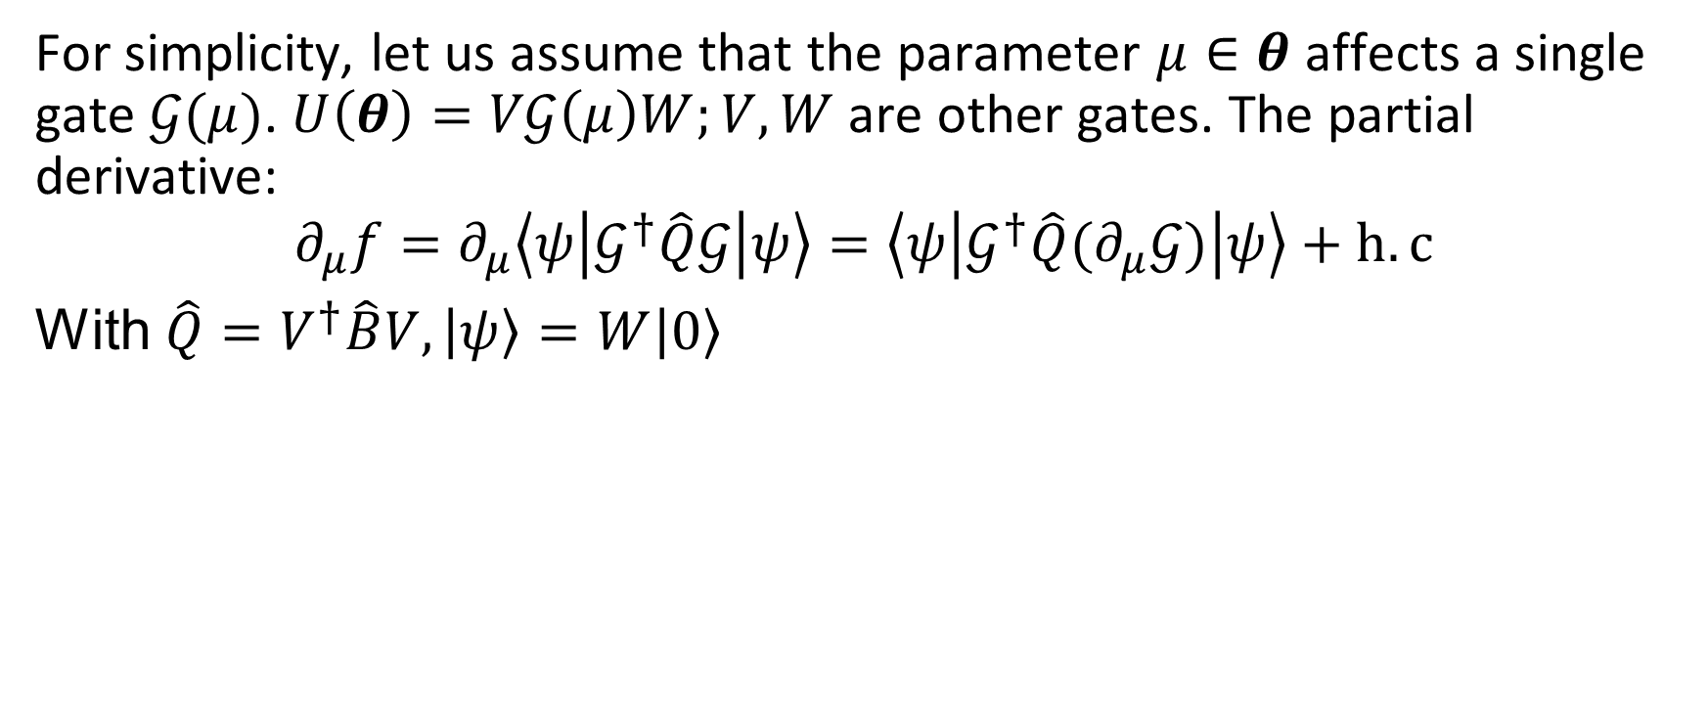
3. Summary
For simplicity, let us assume that the parameter $μ∈θ$ affects a single gate $𝒢(μ)$. $U\left(θ\right)=V𝒢\left(μ\right)W;V,W$ are other gates. The partial derivative:
$$∂_{μ}f=∂_{μ}\left\langle ψ\left|𝒢^{†}\hat{Q}𝒢\right|ψ\right\rangle =\left\langle ψ\left|𝒢^{†}\hat{Q}(∂_{μ}𝒢)\right|ψ\right\rangle +h.c$$
With $\hat{Q}=V^{†}\hat{B}V,\left|ψ\right\rangle =W\left|0\right\rangle$
For more complex $U$, we can use product rule.

Slide 7
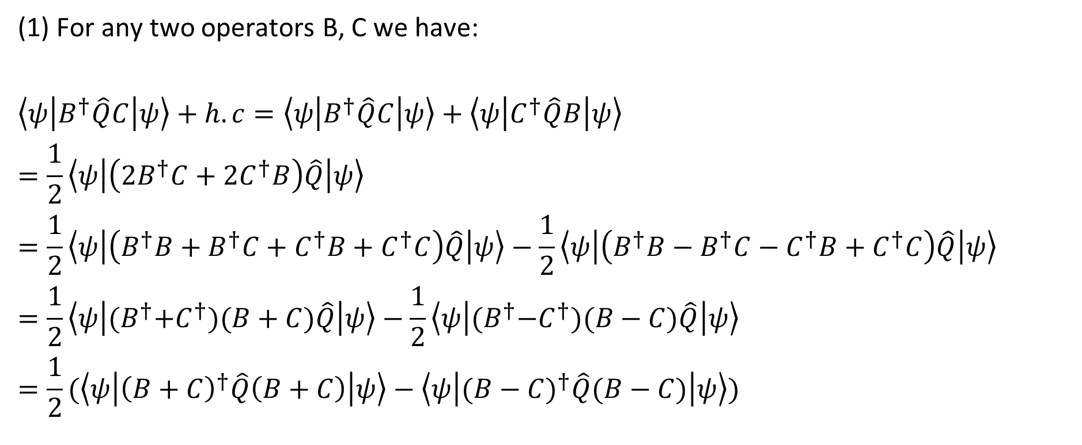
3.1. Proof
(1) For any two operators B, C we have:
$$\left\langle ψ\left|B^{†}\hat{Q}C\right|ψ\right\rangle +h.c=\left\langle ψ\left|B^{†}\hat{Q}C\right|ψ\right\rangle +\left\langle ψ\left|C^{†}\hat{Q}B\right|ψ\right\rangle$$
$$=\frac{1}{2}\left\langle ψ\left|\left(2B^{†}C+2C^{†}B\right)\hat{Q}\right|ψ\right\rangle$$
$$=\frac{1}{2}\left\langle ψ\left|\left(B^{†}B+B^{†}C+C^{†}B+C^{†}C\right)\hat{Q}\right|ψ\right\rangle −\frac{1}{2}\left\langle ψ\left|\left(B^{†}B−B^{†}C−C^{†}B+C^{†}C\right)\hat{Q}\right|ψ\right\rangle$$
$$=\frac{1}{2}\left\langle ψ\left|{(B}^{†}+C^{†})(B+C)\hat{Q}\right|ψ\right\rangle −\frac{1}{2}\left\langle ψ\left|{(B}^{†}−C^{†})(B−C)\hat{Q}\right|ψ\right\rangle$$
$$=\frac{1}{2}(\left\langle ψ\left|{\left(B+C\right)}^{†}\hat{Q}\left(B+C\right)\right|ψ\right\rangle −\left\langle ψ\left|({B−C)}^{†}\hat{Q}(B−C)\right|ψ\right\rangle )$$

Slide 8
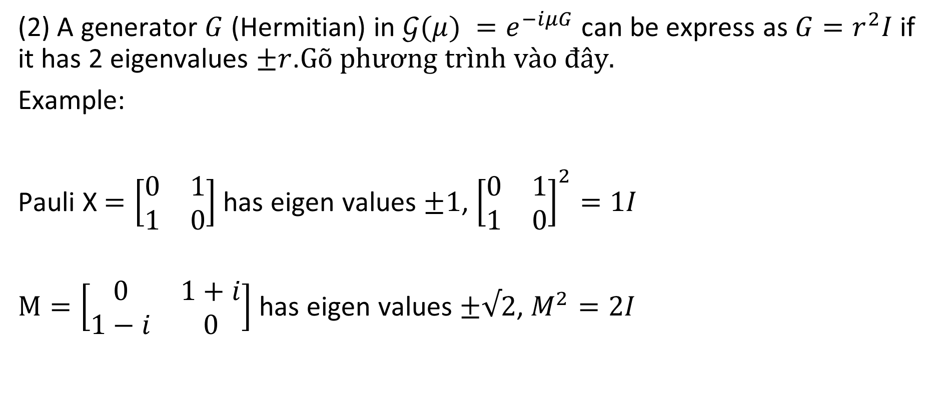
3.1. Proof
(2) A generator $G$ (Hermitian) in $𝒢(μ) =e^{−iμG}$ can be express as ${G=r}^{2}I$ if it has 2 eigenvalues $±r$.
Example:
Pauli X $=\left[\begin{matrix}0 & 1 \\ 1 & 0\end{matrix}\right]$ has eigen values $±1$, ${\left[\begin{matrix}0 & 1 \\ 1 & 0\end{matrix}\right]}^{2}=1I$
$M=\left[\begin{matrix}0 & 1+i \\ 1−i & 0\end{matrix}\right]$ has eigen values $±√2$, $M^{2}=2I$

Slide 9
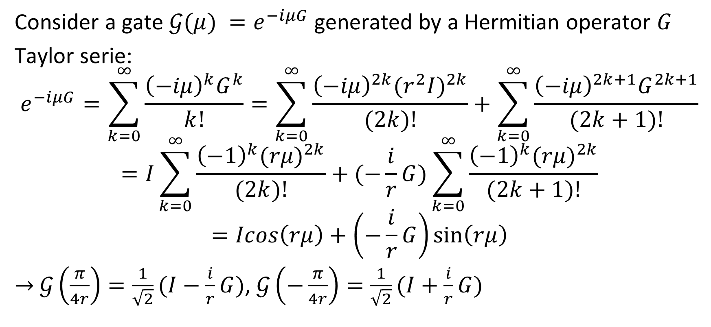
3.1. Proof
Consider a gate $𝒢(μ) =e^{−iμG}$generated by a Hermitian operator $G$
Taylor serie:
$$e^{−iμG}=\sum_{k=0}^{∞}{\frac{{\left(−iμ\right)}^{k}G^{k}}{k!}}=\sum_{k=0}^{∞}{\frac{{\left(−iμ\right)}^{2k}{(r^{2}I)}^{2k}}{(2k)!}+\sum_{k=0}^{∞}{\frac{{\left(−iμ\right)}^{2k+1}G^{2k+1}}{(2k+1)!}}}$$
$$=I\sum_{k=0}^{∞}{\frac{{\left(−1\right)}^{k}{(rμ)}^{2k}}{(2k)!}+(−\frac{i}{r}G)\sum_{k=0}^{∞}{\frac{{\left(−1\right)}^{k}{(rμ)}^{2k}}{(2k+1)!}}}$$
$$=Icos\left(rμ\right)+\left(−\frac{i}{r}G\right)\sin\left(rμ\right)$$
$→$ $𝒢\left(\frac{π}{4r}\right)=\frac{1}{\sqrt{2}}(I−\frac{i}{r}G)$, $𝒢\left(−\frac{π}{4r}\right)=\frac{1}{\sqrt{2}}(I+\frac{i}{r}G)$

Slide 10
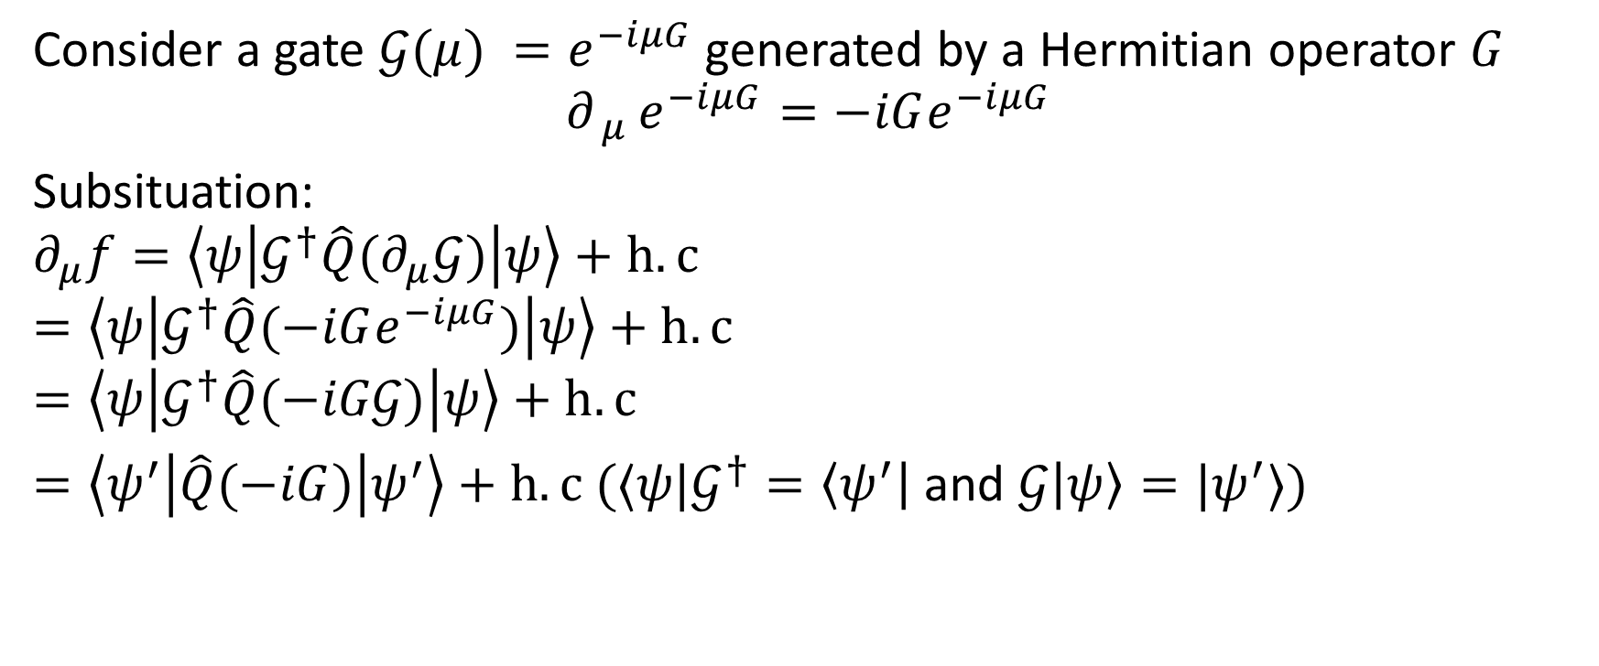

3.2. Summary
Consider a gate $𝒢(μ) =e^{−iμG}$generated by a Hermitian operator $G$
$${∂_{ μ }e}^{−iμG}=−iGe^{−iμG}$$
Subsituation:
$$∂_{μ}f=\left\langle ψ\left|𝒢^{†}\hat{Q}(∂_{μ}𝒢)\right|ψ\right\rangle +h.c$$
$$=\left\langle ψ\left|𝒢^{†}\hat{Q}(−iGe^{−iμG})\right|ψ\right\rangle +h.c$$
$$=\left\langle ψ\left|𝒢^{†}\hat{Q}(−iG𝒢)\right|ψ\right\rangle +h.c$$
$=\left\langle ψ^{′}\left|\hat{Q}(−iG)\right|ψ^{′}\right\rangle +h.c (⟨ψ|𝒢^{†}=\left\langle ψ^{′}\right|$ and $𝒢\left|ψ\right\rangle =|ψ^{′}⟩)$

Slide 11
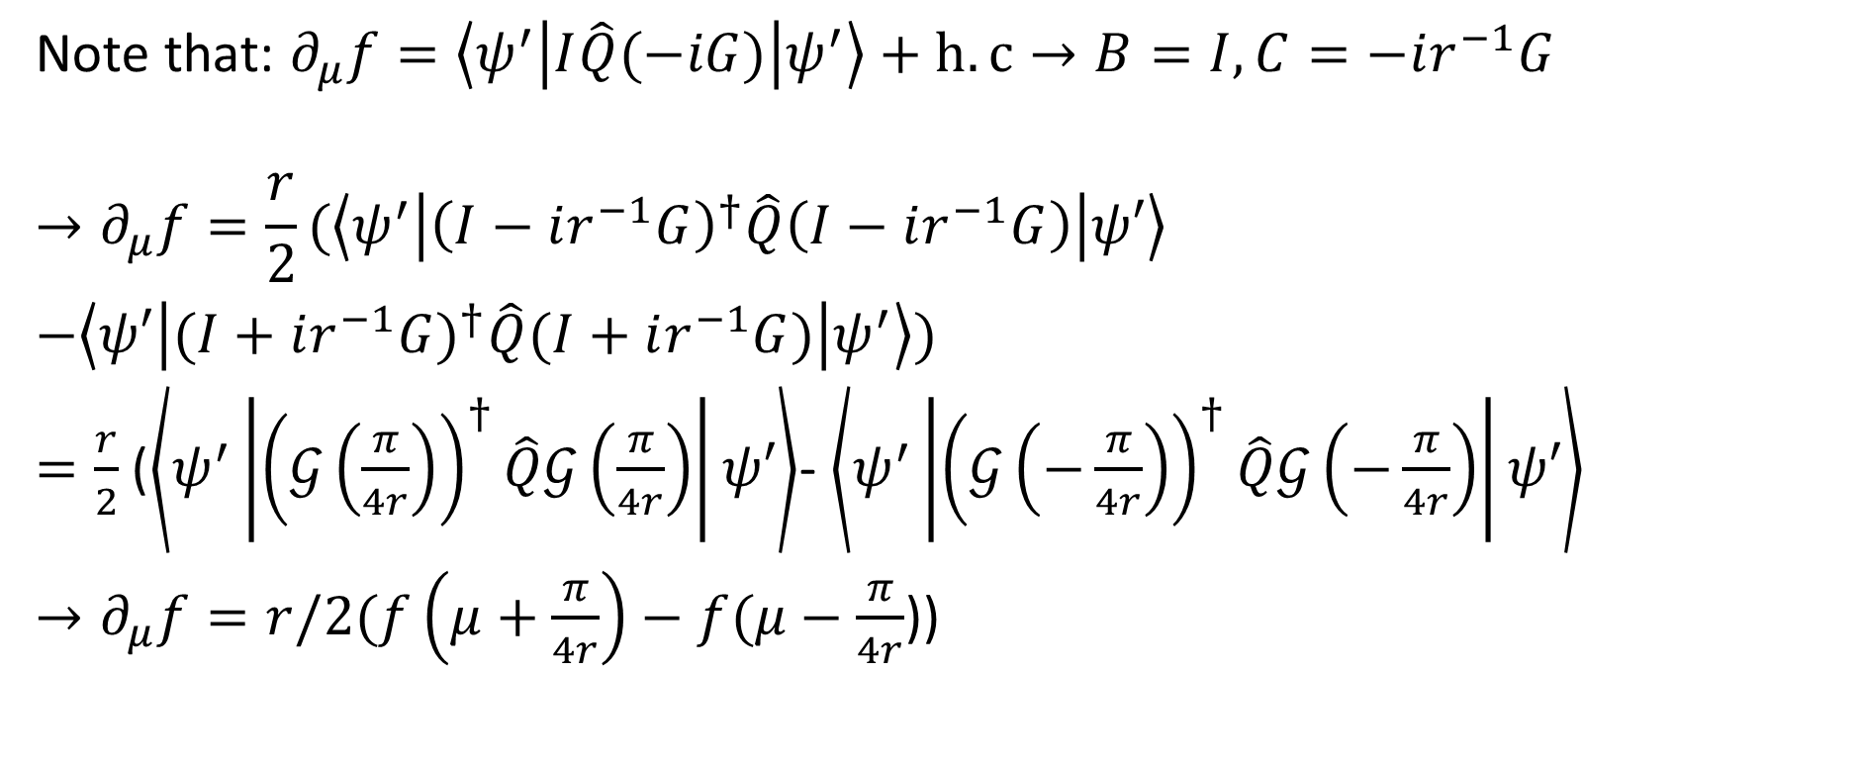
3.2. Summary
Note that: $∂_{μ}f=\left\langle ψ^{′}\left|I\hat{Q}(−iG)\right|ψ^{′}\right\rangle +h.c→B=I, C=−ir^{−1}G$
$$→∂_{μ}f=\frac{r}{2}(\left\langle ψ^{′}\left|{\left(I−ir^{−1}G\right)}^{†}\hat{Q}\left(I−ir^{−1}G\right)\right|ψ′\right\rangle$$
$−\left\langle ψ′\left|({I+ir^{−1}G)}^{†}\hat{Q}(I+ir^{−1}G)\right|ψ^{′}\right\rangle )$
$=\frac{r}{2}$ ($\left\langle ψ^{′}\left|{\left(𝒢\left(\frac{π}{4r}\right)\right)}^{†}\hat{Q}𝒢\left(\frac{π}{4r}\right)\right|ψ′\right\rangle$- $\left\langle ψ^{′}\left|{\left(𝒢\left(−\frac{π}{4r}\right)\right)}^{†}\hat{Q}𝒢\left(−\frac{π}{4r}\right)\right|ψ′\right\rangle$
$→∂_{μ}f=r/2(f\left(μ+\frac{π}{4r}\right)−f(μ−\frac{π}{4r}$))

Slide 12
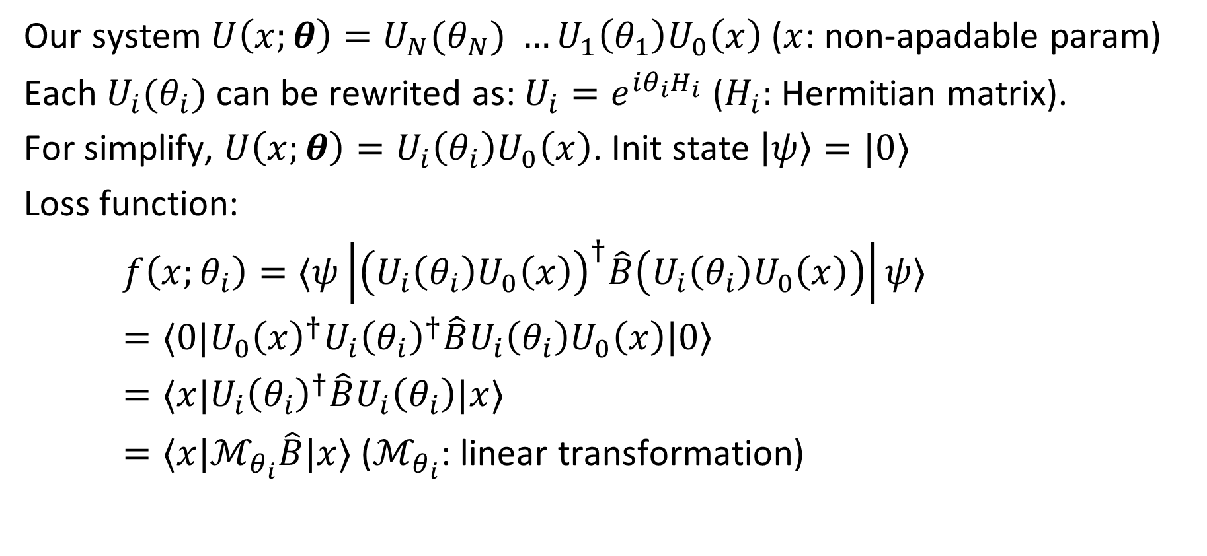
2.2. Summary
Our system $U\left(x;θ\right)=U_{N}(θ_{N}) …{U_{1}\left(θ_{1}\right)U}_{0}\left(x\right)$($x$: non-apadable param)
Each $U_{i}(θ_{i})$ can be rewrited as: $U_{i}=e^{iθ_{i}H_{i}}$ ($H_{i}:$ Hermitian matrix).
For simplify, $U\left(x;θ\right)=U_{i}\left(θ_{i}\right)U_{0}\left(x\right)$. Init state $\left|ψ\right\rangle =|0⟩$
Loss function:
$f\left(x;θ_{i}\right)=⟨ψ\left|{\left(U_{i}\left(θ_{i}\right)U_{0}\left(x\right)\right)}^{†}\hat{B}\left(U_{i}\left(θ_{i}\right)U_{0}\left(x\right)\right)\right|ψ⟩$
$=⟨0|U_{0}{\left(x\right)}^{†}U_{i}{\left(θ_{i}\right)}^{†}\hat{B}U_{i}\left(θ_{i}\right)U_{0}\left(x\right)\left|0\right\rangle$
$=⟨x|U_{i}{\left(θ_{i}\right)}^{†}\hat{B}U_{i}\left(θ_{i}\right)|x⟩$
$=⟨x|ℳ_{θ_{i}}\hat{B}|x⟩$ ($ℳ_{θ_{i}}$: linear transformation)
Notes:
x: input

Slide 13
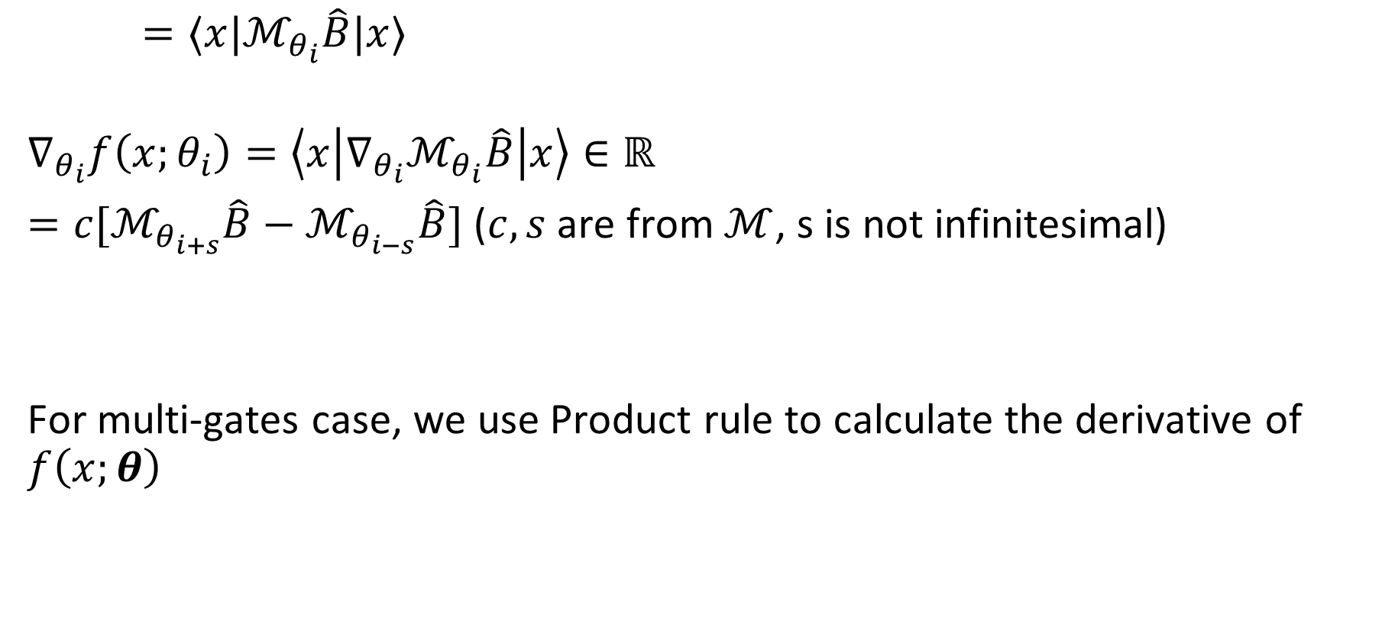
2.2. Summary
$=⟨x|ℳ_{θ_{i}}\hat{B}|x⟩$
$$∇_{θ_{i}}f\left(x;θ_{i}\right)=\left\langle x\left|{∇_{θ_{i}}ℳ}_{θ_{i}}\hat{B}\right|x\right\rangle ∈ℝ$$
$=c[ℳ_{θ_{i+s}}\hat{B}−ℳ_{θ_{i−s}}\hat{B}]$ ($c,s$ are from $ℳ$, s is not infinitesimal)
For multi-gates case, we use Product rule to calculate the derivative of $f\left(x;θ\right)$
Notes:
x: input

Slide 14
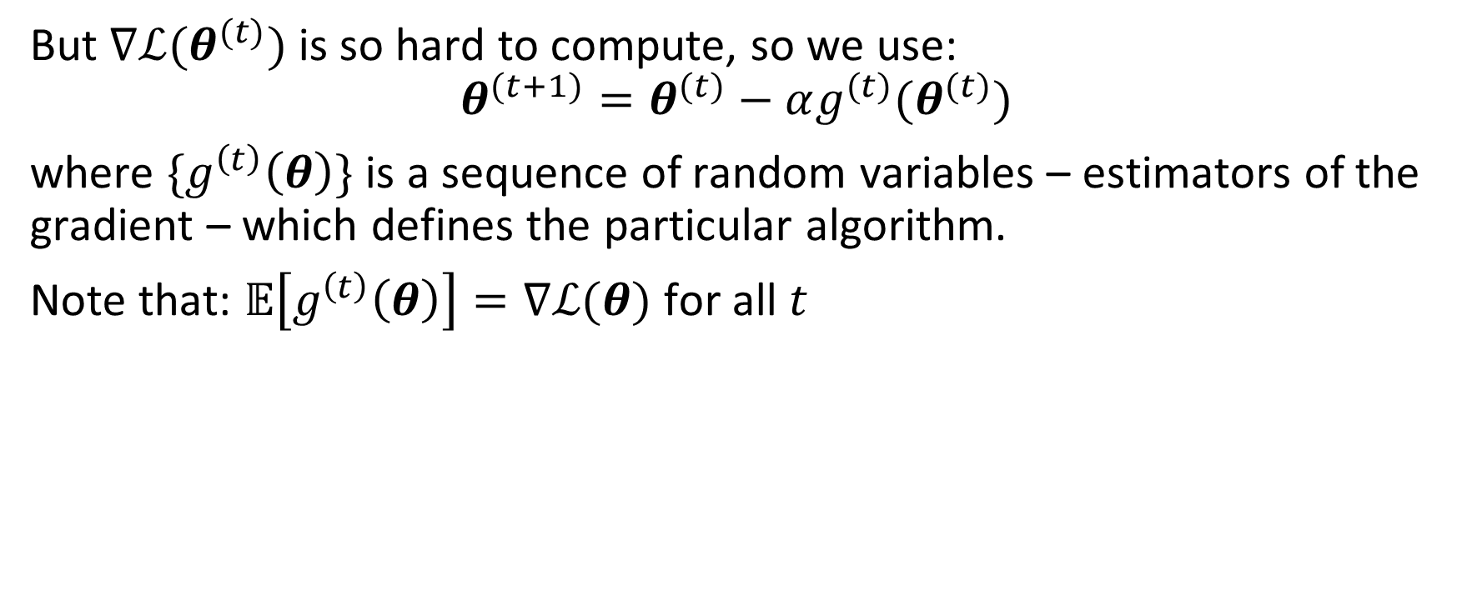
But $∇ℒ(θ^{(t)})$ is so hard to compute, so we use:
$$θ^{(t+1)}=θ^{(t)}−αg^{(t)}(θ^{(t)})$$
where ${\{g}^{\left(t\right)}\left(θ\right)\}$ is a sequence of random variables – estimators of the gradient – which defines the particular algorithm.
Note that: $𝔼\left[g^{\left(t\right)}\left(θ\right)\right]=$ $∇ℒ(θ)$ for all $t$

Slide 15
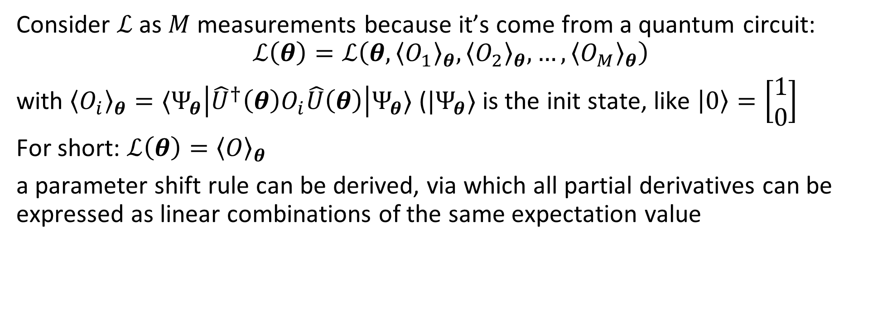
Consider $ℒ$ as $M$ measurements because it’s come from a quantum circuit:
$$ℒ\left(θ\right)=ℒ\left(θ,{\left\langle O_{1}\right\rangle }_{θ},{\left\langle O_{2}\right\rangle }_{θ},…,{\left\langle O_{M}\right\rangle }_{θ}\right)$$
with ${\left\langle O_{i}\right\rangle }_{θ}=⟨Ψ_{θ}\left|{\hat{U}}^{†}\left(θ\right)O_{i}\hat{U}\left(θ\right)\right|Ψ_{θ}⟩$ (${|Ψ}_{θ}⟩$ is the init state, like $\left|0\right\rangle =\left[\begin{matrix}1 \\ 0\end{matrix}\right]$
For short: $ℒ\left(θ\right)={\left\langle O\right\rangle }_{θ}$
a parameter shift rule can be derived, via which all partial derivatives can be expressed as linear combinations of the same expectation value

